Slide 1
EMPLOYEE PERFORMANCE ANALYSIS USING EXCEL
PRESENTED BY: GANESH KUMAR S
REGISTER NO: 312204467,2CBD3D910514BD29BAE49C0D2D4D8F58
DEPARTMENT: BCOM GEN
COLLEGE: K.C.S KASI NADAR COLLEGE ARTS AND SCIENCE

Slide 2

PROJECT TITLE
Employee Salary Based Upon Department work

Slide 3
AGENDA
Problem statement
Project overview
End users
Our solution and proposition
Dataset description
Modeling approach
Results and discussion
Conclusion

Slide 4
PROBLEM STATEMENT
You need to develop a system or formula to calculate employee salaries based on the department they work in.
Different departments might have different salary structures depending on factors such as the nature of the work, skill requirements, experience, performance, and market standards..

Slide 5

PROJECT OVERVEIW
employee salary based upon department work" means that the salary an employee earns is directly influenced by the department they are a part of, considering the work they perform, the skills required, and the market standards for that specific type of work.

Slide 6
WHO ARE THE END USERS?
HR Department
Finance Department
Department Managers
Employees
Executives And Leadership
Payroll Administrators
It Department
Compliance Officers

Slide 7
OUR SOLUTION AND ITS VALUE PROPOSITION
Filtering- remove missing values
Pivot table- summary of employee performance
Formulas `- IFS
Graphs- Final Report

Slide 8
Dataset Description
BUSINESS UNIT: The specific business unit or department to which the employee
Employee ID: Unique identifier for each employee in the organization.
First Name: The first name of the employee.
Last Name: The last name of the employee.
Start Date: The date when the employee started working for the organization.
Exit Date: The date when the employee left or exited the organization (if applicable).
Title: The job title or position of the employee within the organization.
Supervisor: The name of the employee's immediate supervisor or manager.
Email: The email address associated with the employee's communication within the organization.
Business Unit: The specific business unit or department to which the employee belongs.
Employee Status: The current employment status of the employee (e.g., Active, On Leave, Terminated).
Employee Type: The type of employment the employee has (e.g., Full-time, Part-time, Contract).

Slide 9
MODELLING
Data set: Kaggle , Employee dataset
Feature Selection:
Data Cleaning: Missing values, Irrelevant.
Formula : performance calculation, low, med, high
Pivot table : summary, business unit, gender, emploment type, employee id, performance.
Chart: Report: slicer

Slide 10
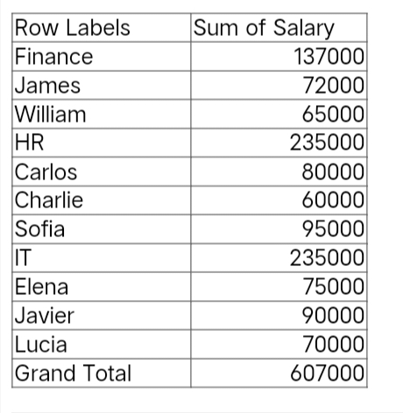
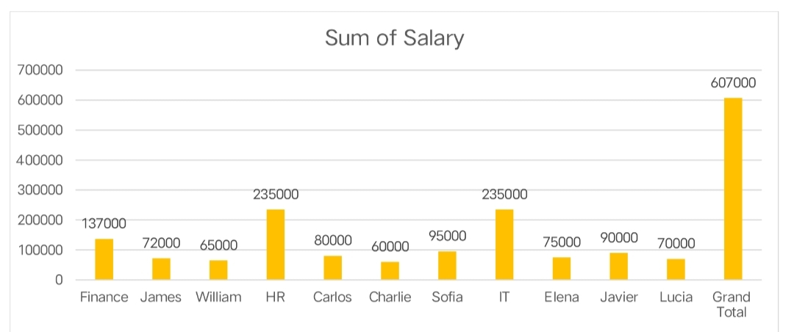
RESULT

Slide 11
CONCLUSION
After analyzing the salary distribution across departments and correlating it with employee performance metrics, it is evident that departments such as Sales and Engineering exhibit strong performance that justifies their higher average salaries. However, the data also reveals discrepancies in departments like Administration, where salaries are relatively high, yet performance lags behind. To address these disparities, we recommend targeted salary adjustments and performance improvement initiatives. Regular monitoring of this data will ensure that compensation remains fair and performance-driven across the organization

